Slide 2
March Performance

Slide 3
Live Associates
S.No | Name | Points | Percentage | No Of Working Days | Attendance %
1 | Herald | 2027 | 98% | 18 | 90%
2 | Heidi | 1661 | 98% | 20 | 100%
3 | Grace | 1258 | 114% | 13 | 65%
4 | Regina | 1727 | 139% | 20 | 100%
5 | Regin | 1601 | 129% | 20 | 100%
6 | Pamela | 565 | 78% | 16 | 80%
7 | Evangeline | 826 | 92% | 20 | 100%
8 | Patrick N | 1064 | 118% | 20 | 100%
9 | Michael | 1288 | 143% | 20 | 100%
10 | Nancy | 809 | 95% | 19 | 95%

Slide 7
Trainees
S.No | Name | Points | Percentage | No Of Working Days | Attendance %
1 | Jaymoun | 1098 | 165% | 19 | 95%
2 | Sheryll | 981 | 140% | 20 | 100%
3 | Aeleta | 861 | 137% | 18 | 90%
4 | Melissa | 898 | 128% | 20 | 100%
5 | Reggie | 800 | 200% | 16 | 100%
6 | Nicole | 807 | 202% | 16 | 100%
7 | Paolo | 851 | 213% | 16 | 100%
8 | Kristel | 998 | 250% | 16 | 100%
9 | Jeff | 105 | 70% | 6 | 100%
10 | Lourdes | 93 | 62% | 6 | 100%

Slide 12
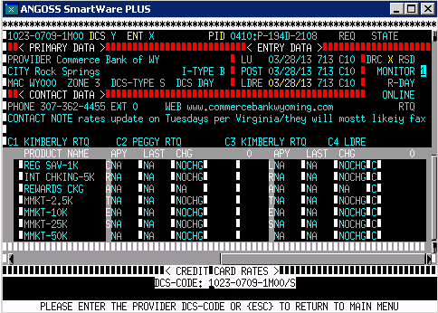
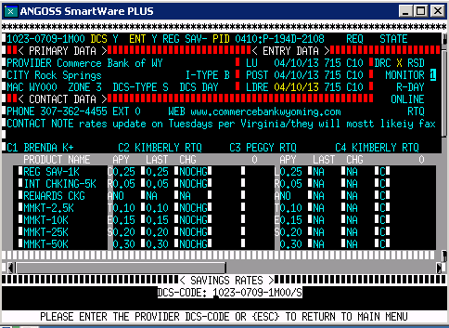
We have been unable to do so several times in the past because the bank would always refuse to quote their rates. Great job Nicole! I appreciate your persistence and hard work. Keep it up. =)
I just wanted to commend Nicole for being able to collect all the rates for this bank:

Slide 13
I just want to commend Des for doing an excellent job at collecting rates from an institution which continuously refused to quote. We all know how difficult it is to collect rates when we are being refused all the time by some banking institutions. So, to hear that rates were accurately collected from an institution that continues to refuse to provide one is no mean feat. Kudos Des! Keep it up.

Slide 14
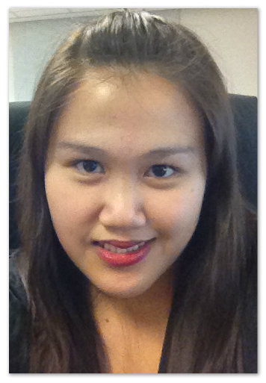
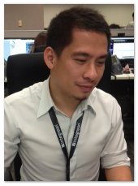
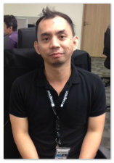
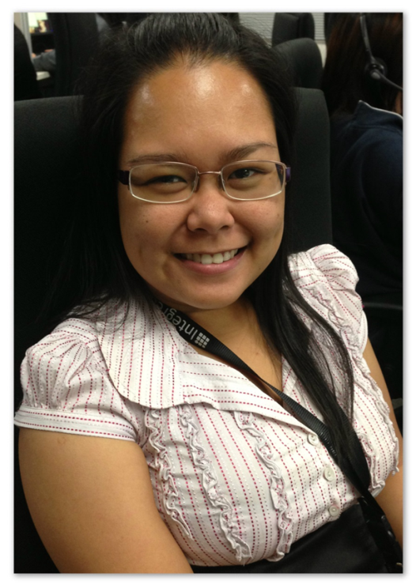
March 04,2013
Nicole
Paulo
Reggie
Kristel

Slide 15
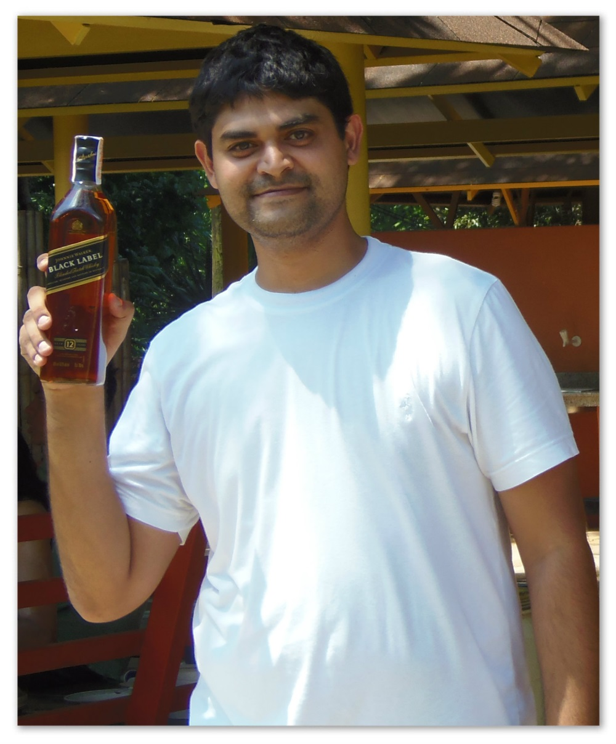
March 11, 2013
SID

Slide 16
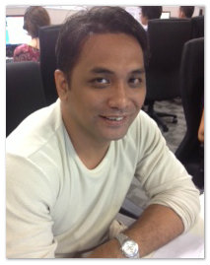
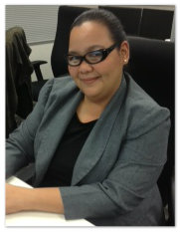
March 18,2013
JEFF
Des

Slide 17
Awards

Slide 18
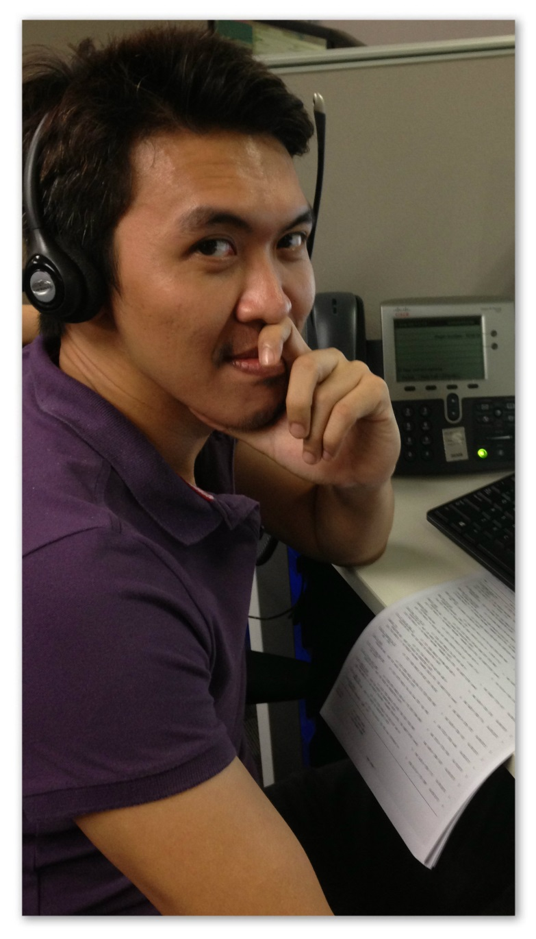
Rejin Sortijas
"Rej has done it this time... If there was an award for most improved, I would gladly give it to him. But Top Performer for March will do for now. Congratulations Rej! You turned the table upside down and proved that you've got the potential to be amongst the best. I hope you continue improving and always aim for the top. Have confidence in yourself and know that you have a team that supports you.”
PRODUCTIVITY : 100%
QUALITY : 100%
ATTENDANCE : 100%

Slide 19
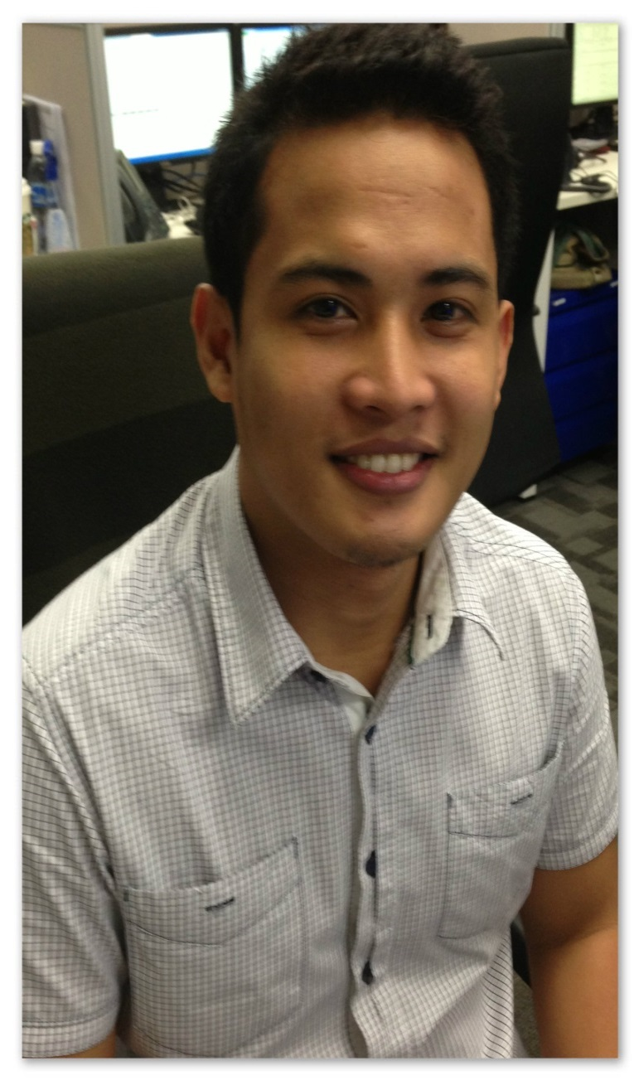
Michael Gabriel
"Gab being the top performer for the month comes as no surprise. He has consistently done a great job at collecting rates with efficiency and accuracy. He has proven to have the right attitude and work ethics all throughout his tenure with Bank Rates befitting a top performer. So 2 for 2, SPARC and Top Performer...2nd time lucky? I don't think so...Congratulations Gab! Well deserved.“
PRODUCTIVITY : 143%
QUALITY : 100%
ATTENDANCE : 100%

Slide 20
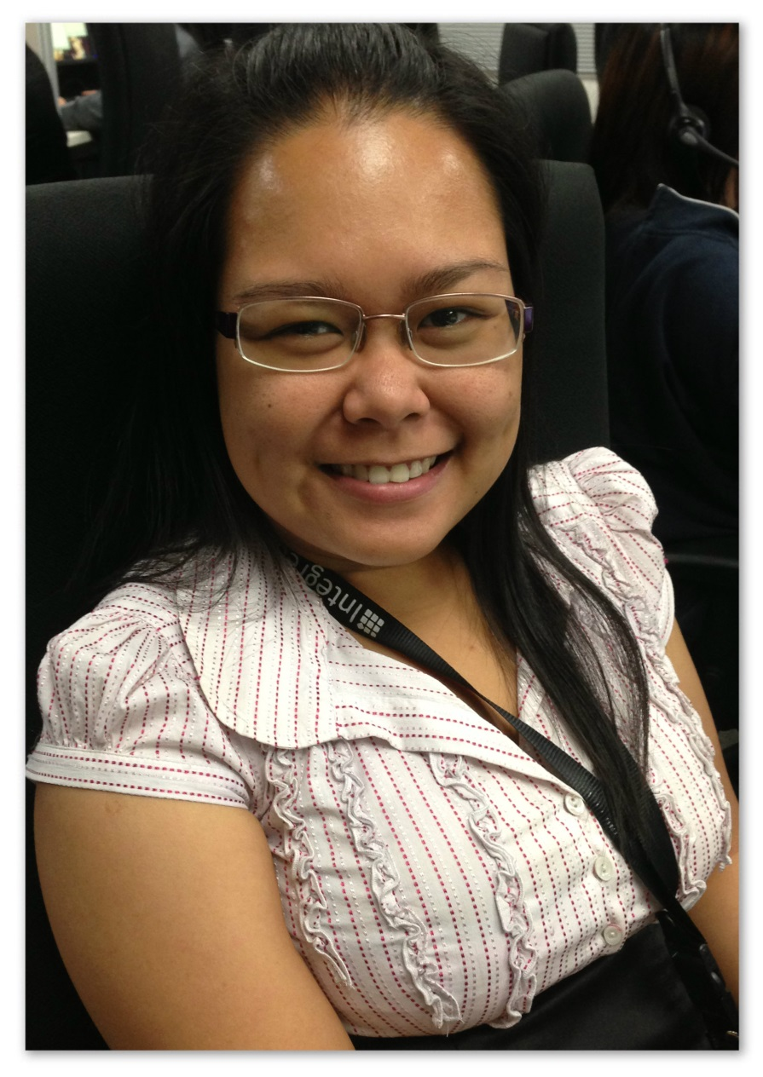
Kristel Catolico
"Kristel's performance is commendable. Even while in training she has done an excellent job at learning the products quickly and able to collect rates efficiently and accurately. She continues to demonstrate the kind of work ethics and attitude expected of her. Congratulations Tel! Keep up the great work and you will go a long way.“
PRODUCTIVITY : 250%
QUALITY : 98%
ATTENDANCE : 100%

Slide 21
“Great teams do not hold back with one another. They are unafraid to air their dirty laundry. They admit their mistakes, their weaknesses, and their concerns without fear of reprisal.”

Slide 22
BANK RATES
APRIL 15, 2013

